Slide 1
Congruent triangles (ASA and AAS)
Geometrical properties: similarity and Pythagoras' theorem

Slide 2
how to use Oak lessons

Slide 3
I can appreciate and use the criteria by which triangles are congruent (ASA and AAS).

Slide 4
If one shape can fit exactly on top of another using rotation, reflection or translation, then the shapes are congruent.

Slide 5

Congruent triangles (ASA and AAS)
Constructing triangles
Justifying congruence by ASA/AAS

Slide 6
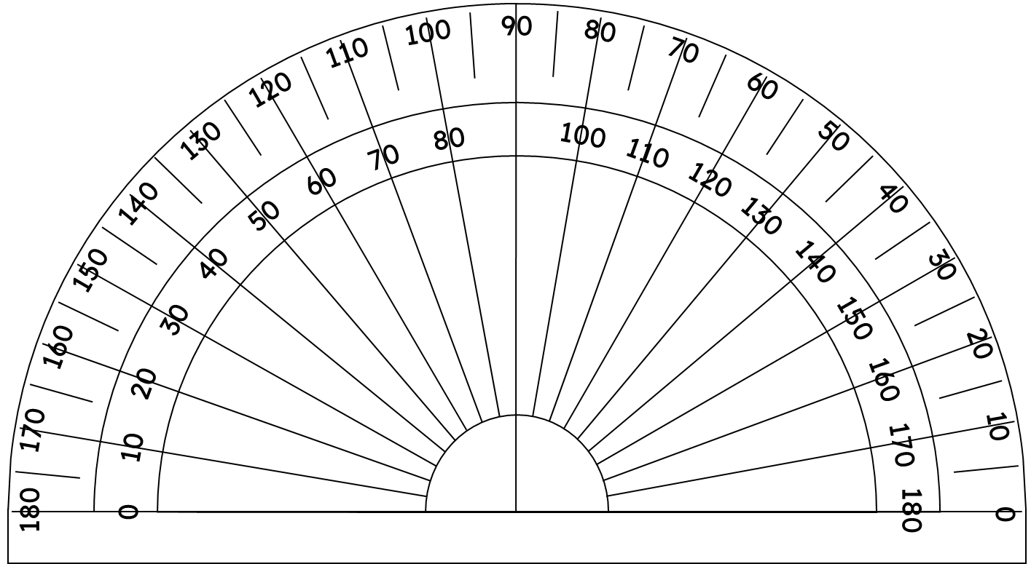
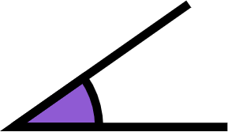
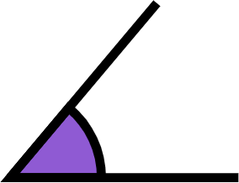
Constructing triangles
If we want to construct a triangle with an angle of 50° and an angle of 35°, how can we do it?
We can create the two angles using a protractor.
35°
50°

Slide 7
Constructing triangles
If we want to construct a triangle with an angle of 50° and an angle of 35°, how can we do it?
The legs of the angle, are rays from the vertex.
35°
50°

Slide 8
Constructing triangles
If we want to construct a triangle with an angle of 50° and an angle of 35°, how can we do it?
By lining up one of the rays of each angle, this forms a side of the triangle.
The other rays, intersect at the third vertex.
35°
50°
35°

Slide 9
Constructing triangles
If we want to construct a triangle with an angle of 50° and an angle of 35°, how can we do it?
A different triangle can be formed by moving the two angles further apart or closer together.
50°
35°
35°
35°

Slide 10
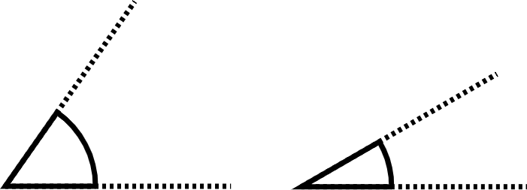
Constructing triangles
How many different triangles can be created using these two angles?
55°
30°
an infinite number

Slide 11
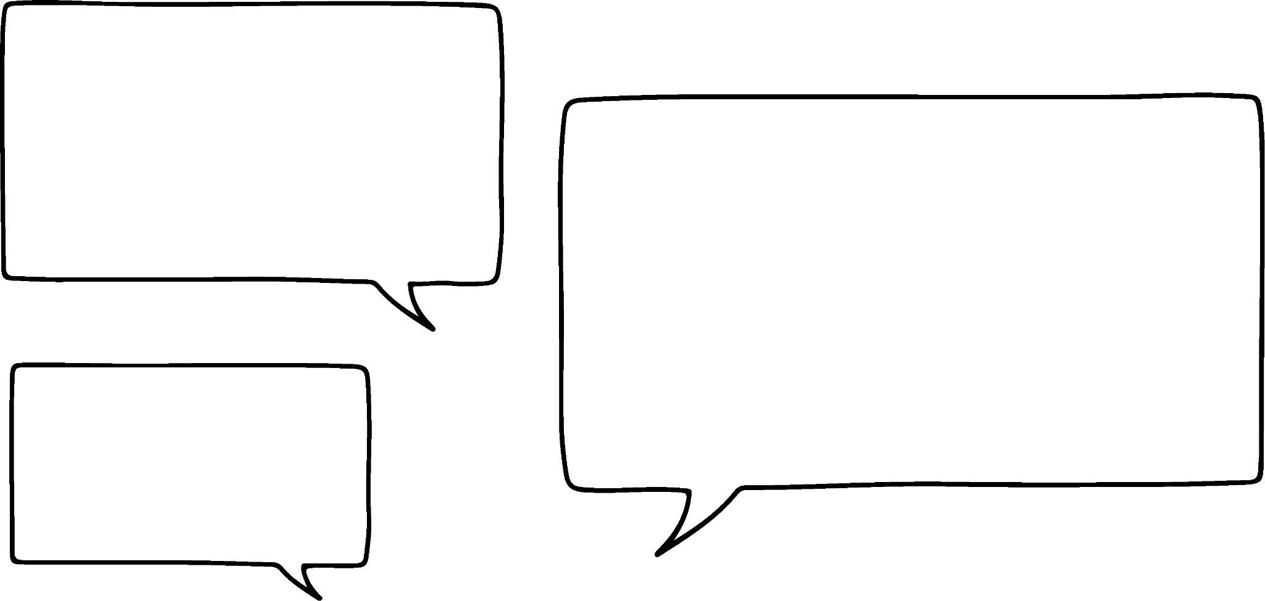


Constructing triangles
If the side length between the two vertices is also known, then only one triangle will be constructed.
For example, the edge between the two angles 50° and 35° is 6 cm.
Doesn’t it matter which end the angles are?
No, it would just be a reflection of this triangle.
50°
Sofia
35°
6 cm
Laura

Slide 12
Constructing triangles
A triangle can be constructed, if we know the angles at either end of a known edge length.
Construct triangle MNO, where MN = 7 cm, ∠OMN = 72° and ∠ONM = 43°.
O
72°
43°
M
7 cm
N

Slide 13

Constructing triangles
Jun has tried to construct the triangle PQR, where PQ = 9 cm, ∠RPQ = 135° and ∠RQP = 20°.
R
It hasn’t formed a triangle.
135°
20°
P
9 cm
Q
What has Jun done wrong?
He needs to extend his ray lines, so they intersect to find R.

Slide 14
Constructing triangles
O
Can a triangle be constructed, if we know the length of an edge and two angles that aren’t at either end of that line AAS?
35°
O
🖇 Fixing two angles
O
35°
35°
50°
M
6 cm
N

Slide 15
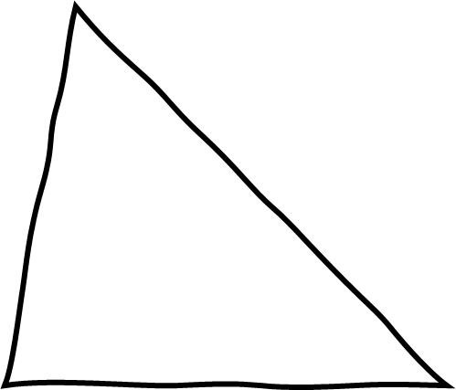
Constructing triangles
Can a triangle be constructed, if we know AAS?
Yes, as we can calculate the third angle.
For example: Construct triangle MNO, where MN = 7 cm, ∠MON = 70° and ∠ONM = 45°.
a sketch
∠OMN = 180 - (70 + 45) = 180 - 115 = 65°
O
70°
Now, we can construct, using the 7 cm, the 65° and the 45° angles.
65°
45°
N
M
7 cm

Slide 16

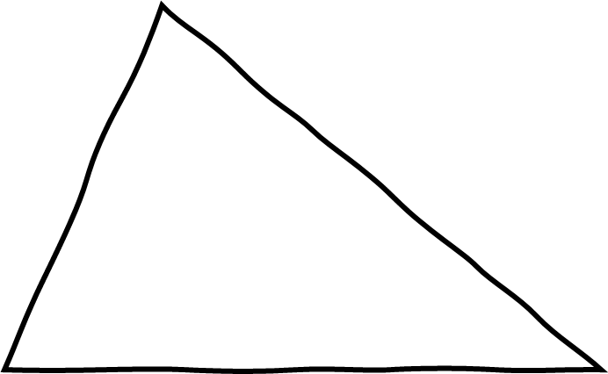
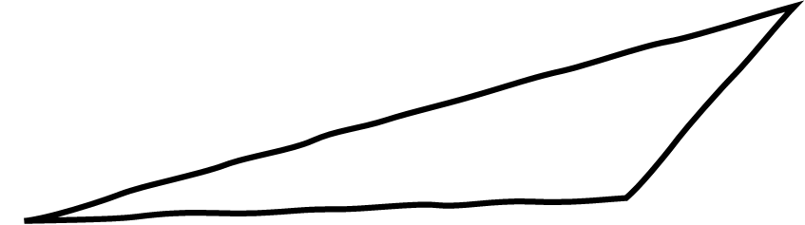

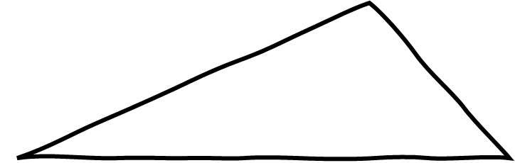
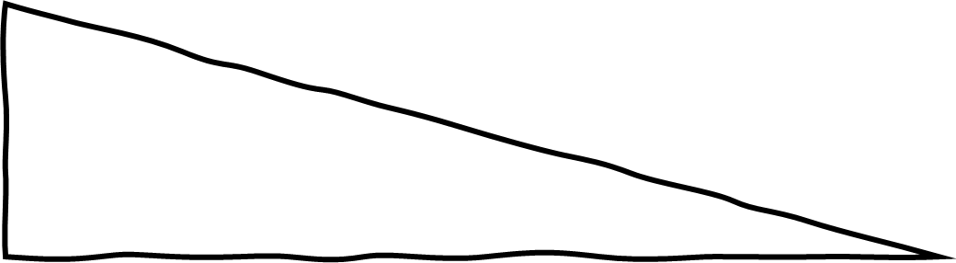
Constructing triangles
Which of these sketches have enough information to be able to construct them?
a
b
133°
72°
59°
9.2 cm
7 cm
87 mm
c
d
80°
90°
27°

Slide 17
Constructing triangles
1) Construct the following triangles:
a) Triangle ABC, where AB = 7.5 cm, ∠CAB = 54° and ∠ABC = 47°
b) Triangle DEF, where ∠DEF = 67°, ∠EFD = 25° and EF = 8.2 cm
c) Triangle GHI, where GH = 7.1 cm, ∠GHI = 113° and ∠HIG = 42°
d) Triangle JKL, where ∠JKL = 38°, JL = 5.6 cm and KJ = KL

Slide 18
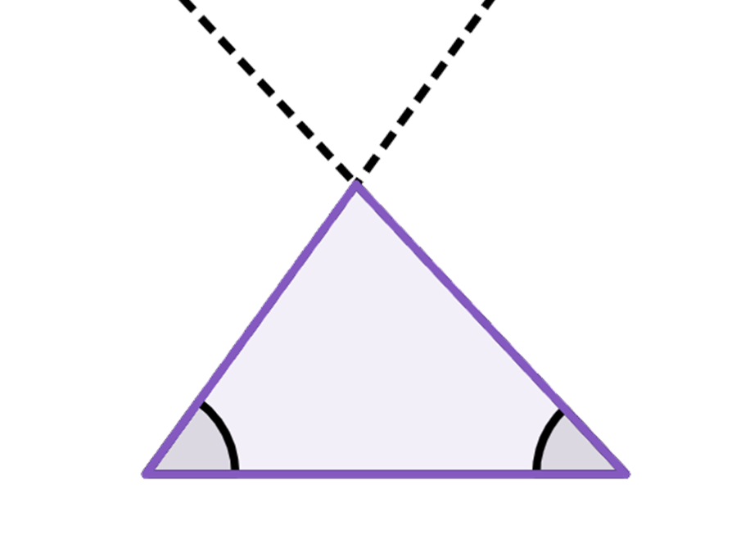
Constructing triangles
1) Construct the following triangles:
a) Triangle ABC, where AB = 7.5 cm, ∠CAB = 54° and ∠ABC = 47°
C
If you measure ∠ACB it should be 79° and BC should be 6.2 cm
54°
47°
A
B
7.5 cm

Slide 19
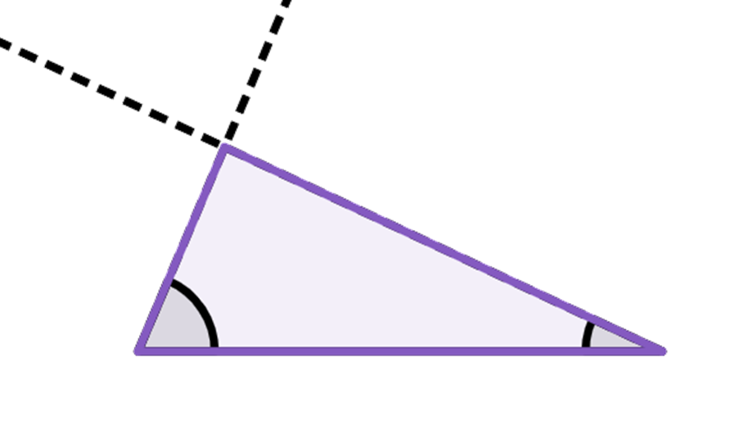
Constructing triangles
1) Construct the following triangles:
b) Triangle DEF, where ∠DEF = 67°, ∠EFD = 25° and EF = 8.2 cm
If you measure ∠EDF it should be 88° and DE should be 3.5 cm
D
67°
25°
E
F
8.2 cm

Slide 20
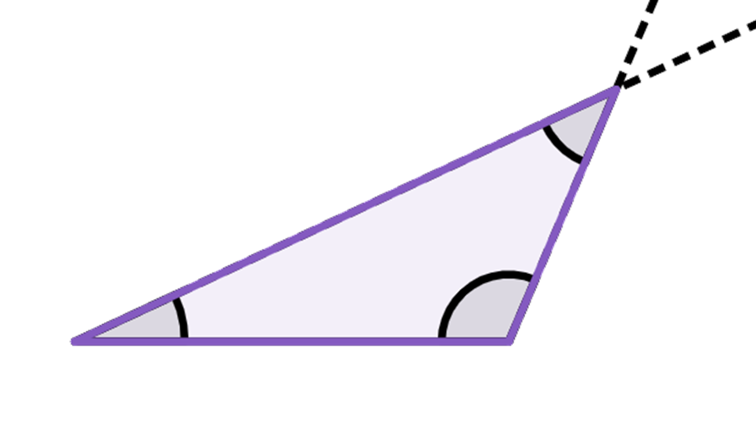
Constructing triangles
1) Construct the following triangles:
c) Triangle GHI, where GH = 7.1 cm, ∠GHI = 113° and ∠HIG = 42°
I
If you measure GI it should be 9.8 cm and HI should be 4.5 cm
42°
113°
25°
G
H
7.1 cm

Slide 21
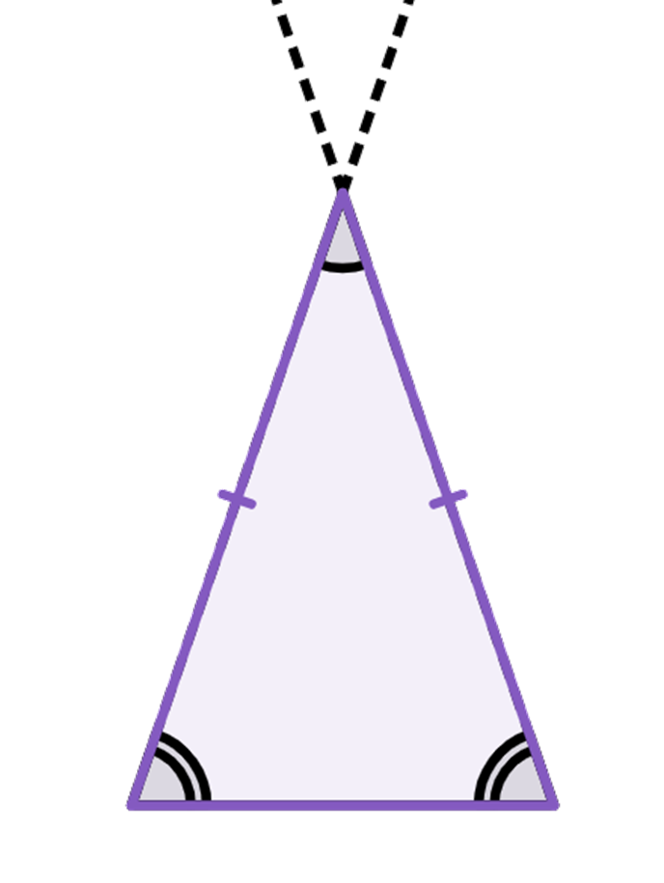
Constructing triangles
1) Construct the following triangles:
d) Triangle JKL, where ∠JKL = 38°, JL = 5.6 cm and KJ = KL
K
If you measure KJ and KL they should both be 8.6 cm
38°
71°
J
L
5.6 cm

Slide 22
Congruent triangles (ASA and AAS)
Constructing triangles
Justifying congruence by ASA/AAS

Slide 23
Justifying congruence by ASA/AAS
Two triangles can be shown to be congruent if all corresponding edges are the same.
The three edges of the triangle, fix the interior angles as well.
A
b
b
× k
c
c
× k
kc
kb
B
a
C
a
× k
The converse is not true. The three angles do not fix the side lengths.
ka
Enlargements will have the same angles.

Slide 24
Justifying congruence by ASA/AAS
To be sure that the triangles are not only similar, at least one edge length needs to be known.
A
b
b
c
c
c
B
a
B
a
C
a
When two edges and the angle between them is known, the third edge is fixed, which in turn fixes the other two angles.

Slide 25
Justifying congruence by ASA/AAS
To be sure that the triangles are not only similar, at least one edge length needs to be known.
A
b
b
c
c
c
B
a
B
a
C
a
If you know one edge length, the size is fixed and by knowing two angles, you in fact know all three.
or
a
a

Slide 26
Justifying congruence by ASA/AAS
To be able to prove two triangles are congruent you must know at least one corresponding angle.
Knowing all three edges is enough to prove two triangles are congruent.
Knowing one angle does not always allow you to calculate the other two.

Slide 27
Justifying congruence by ASA/AAS
If we know one side length and two interior angles, then we can prove that two triangles are congruent.
Prove triangle ABC is congruent to triangle DEF by ASA/AAS.
F
A
9.2 cm
99°
99°
17°
D
17°
C
E
B
9.2 cm
BC = EF = 9.2 cm, ∠ABC = ∠DFE = 99° and ∠ACB = ∠DEF = 17°, so triangle ABC is congruent to triangle DEF by ASA.

Slide 28
Justifying congruence by ASA/AAS
If we know one side length and two interior angles, then we can prove that two triangles are congruent.
Prove triangle QPR is congruent to triangle TUV by ASA/AAS.
Q
V
T
97°
38°
97°
38°
P
R
7.1 cm
45°
7.1 cm
U
∠TVU = 180 - (97 + 45) = 180 - 142 = 38°,
PR = UV = 7.1 cm, ∠PQR = ∠UTV = 97° and ∠QPR = ∠TVU = 38°, triangle QPR is congruent to triangle TUV by AAS.

Slide 29
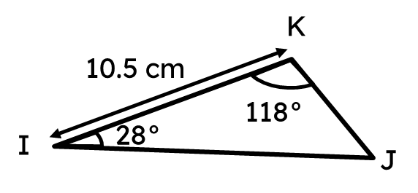
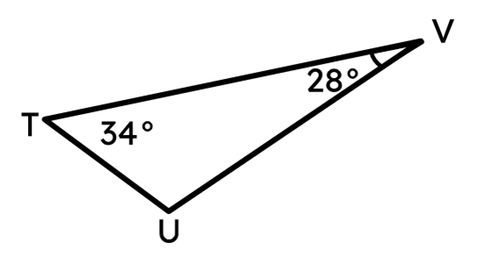
Justifying congruence by ASA/AAS
Triangle IJK and triangle TUV are congruent by AAS.
Which edge corresponds with IK?
UV

Slide 30
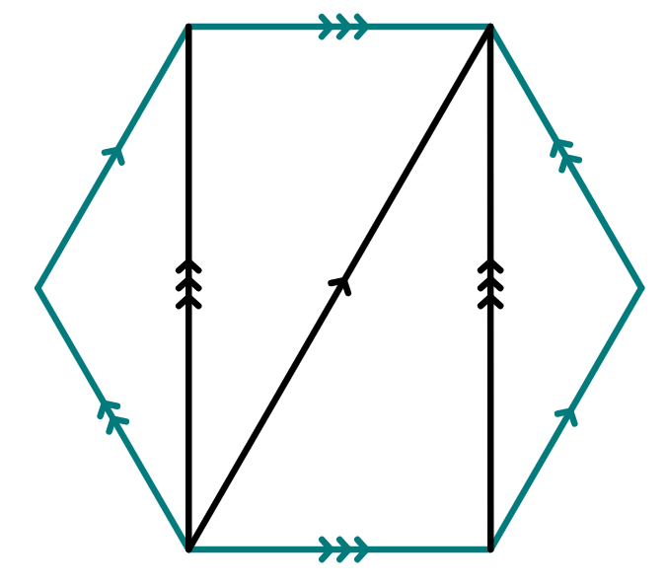


Justifying congruence by ASA/AAS
Many shapes have properties that we can use to prove congruent triangles exist within them.
Here is a regular hexagon ABCDEF, with three diagonals drawn on. Which triangles are congruent to each other?
A
F
∠ABC = ∠DEF (= 120°) as they are interior angles of a regular hexagon.
AB = DE as they are edges of a regular hexagon.
B
E
∠BAC = ∠ACF = ∠CFD = ∠FDE as they are interior alternate angles in parallel lines.
C
D
Hence, ABC and DEF are congruent by ASA.

Slide 31
Justifying congruence by ASA/AAS
Many shapes have properties that we can use to prove congruent triangles exist within them.
Here is a regular hexagon ABCDEF, with three diagonals drawn on. Which triangles are congruent to each other?
A
F
∠AFC = ∠FCD as they are interior alternate angles in parallel lines.
∠ACF = ∠CFD as they are interior alternate angles in parallel lines.
B
E
AF = CD as they are edges of a regular hexagon.
C
D
Hence, AFC and FCD are congruent by AAS.

Slide 32
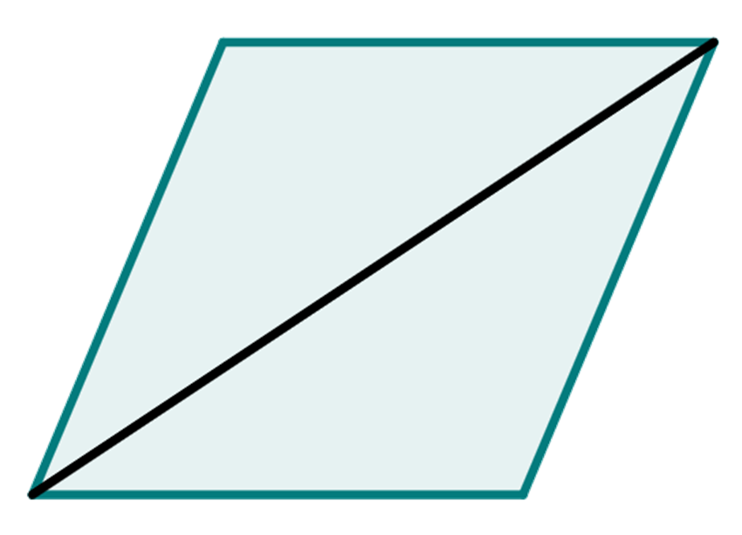
Justifying congruence by ASA/AAS
Complete the proof that triangle ABD and triangle BCD are congruent by AAS/ASA. Given that ABCD is a rhombus.
opposite
A
D
∠DAB = ∠BCD as they are
angles in a rhombus.
BDC
∠ABD = ∠BDC as they are interior alternate angles in parallel lines.
B
C
AB = DC as they are edges of a rhombus.
Hence, ABD and BCD are congruent by ASA.

Slide 33
Justifying congruence by ASA/AAS
1) Prove each pair of triangles are congruent by ASA/AAS.
a)
A
D
F
4.5 cm
71°
91°
91°
71°
4.5 cm
B
C
E
b)
G
J
L
34°
74°
H
34°
29 mm
29 mm
72°
I
K

Slide 34
Justifying congruence by ASA/AAS
2) Why are these two triangles not congruent by ASA?
A
D
4.3 cm
4.3 cm
80°
47°
80°
47°
E
B
C
F
3) Given a parallelogram ABCD, prove that triangle ABC is congruent to triangle ACD by ASA or AAS.

Slide 35
Justifying congruence by ASA/AAS
4) Point E is the midpoint of AC and BD. Prove that triangle AEB is congruent to triangle ECD by ASA/AAS.
D
A
E
C
B

Slide 36
Justifying congruence by ASA/AAS
1) Prove each pair of triangles are congruent by ASA/AAS.
a)
A
D
F
4.5 cm
71°
91°
91°
71°
4.5 cm
B
C
E
AC and EF are corresponding edges and equal, ∠BAC = ∠DEF and ∠ABC = ∠EDF .
Hence, congruent by AAS.

Slide 37
Justifying congruence by ASA/AAS
1) Prove each pair of triangles are congruent by ASA/AAS.
b)
G
J
L
34°
74°
H
34°
29 mm
29 mm
72°
I
K
∠GIH = 180 - (34 + 74) = 72° and ∠KJL = 180 - (34 + 72) = 74°
GI and JK are corresponding edges and equal, ∠HGI = ∠KJL and ∠GIH = ∠JKL.
Hence, congruent by ASA.

Slide 38
Justifying congruence by ASA/AAS
2) Why are these two triangles not congruent by ASA?
A
D
4.3 cm
4.3 cm
80°
47°
80°
47°
E
B
C
F
Although, the three interior angles of both triangles are the same. The two edges of 4.3 cm are not corresponding edges in the triangles.

Slide 39
Justifying congruence by ASA/AAS
3) Given a parallelogram ABCD, prove that triangle ABC is congruent to triangle ACD by ASA/AAS.
A
D
∠DAC = ∠ACB as they are equal interior alternate angles.
AC is a shared side.
B
C
∠DCA = ∠BAC as they are equal interior alternate angles.
Hence, triangle ABC is congruent to triangle ACD by ASA.

Slide 40
Justifying congruence by ASA/AAS
3) Given a parallelogram ABCD, prove that triangle ABC is congruent to triangle ACD by ASA/AAS.
A
D
AD = BC as they are opposite sides of a parallelogram.
∠DAC = ∠ACB as they are equal interior alternate angles.
B
C
∠DCA = ∠BAC as they are equal interior alternate angles.
Hence, triangle ABC is congruent to triangle ACD by AAS.

Slide 41
Justifying congruence by ASA/AAS
4) Point E is the midpoint of AC and BD. Prove that triangle AEB is congruent to triangle ECD by ASA/AAS.
D
DE = EB, as E is the midpoint of BD.
A
∠AEB = ∠DEC as vertically opposite angles.
E
∠ABE = ∠EDC, as they are equal interior alternate angles.
C
B
Hence, triangle AEB is congruent to triangle ECD by ASA.

Slide 42
Congruent triangles (ASA and AAS)
Two triangles can be proved to be congruent if two corresponding angles and a corresponding side are known to be the same.
If the corresponding side is between the two known angles we say they are congruent by ASA (angle-side-angle).
If the corresponding side is not between the two known angles we say they are congruent by AAS (angle-angle-side).

Slide 43

© Oak National Academy 2024.
Produced in partnership with Mathematics in Education and Industry.
Licensed on the Open Government Licence v3.0, except where otherwise stated. See Oak terms and conditions.

